Slide 1
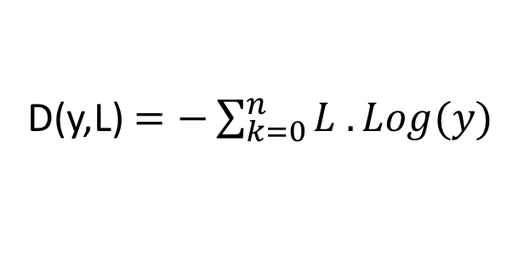
Cross Entropy
Distance Function
y
L
“1”
L
“2”
L
“3”
0.7
0.2
0.1
1.0
0.0
0.0
0.0
1.0
0.0
0.0
0.0
1.0
D(y,L) $=−\sum_{k=0}^{n}{L . Log(y) }$
y dot L1 = - log (0.7) = 0.3566
y dot L2 = -log (0.2) = 1.6
y dot L3 = -log (0.1) = 2.3

